Slide 1
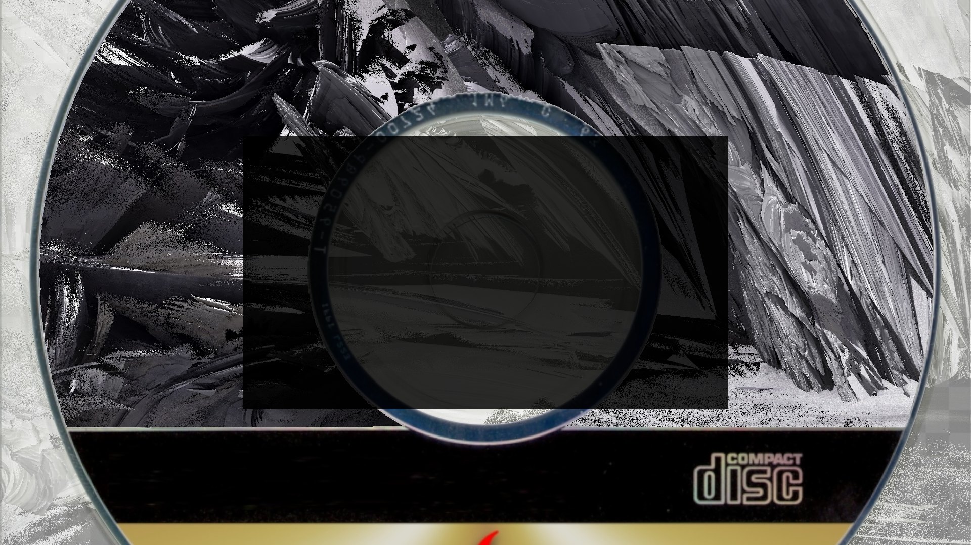
Vanja Venezia
CS 211 Final Project:
ManiacRhythm alpha v0.1

Slide 2
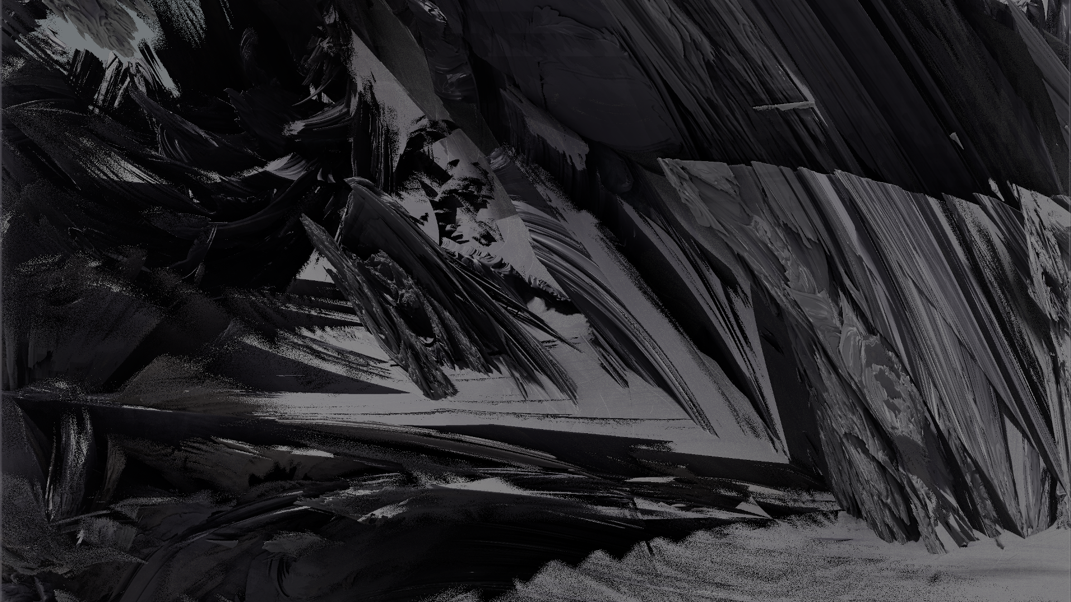
The coolest thing about ManiacRhythm is probably the visual design and audio synced 1080p visualization
I’ve been wanting to make a rhythm game for years and had never actually succeeded in making something playable, the visual direction has been in my head for years though
I had just completed an EP with a slew of visual resources when this project was assigned so I was able to re-appropriate and edit them into something that would function for this game
It just happened to work out that these visual ideas were fully cohesive
Getting the video to work correctly was probably the most difficult aspect of this project outside of tracking missed notes

Slide 3
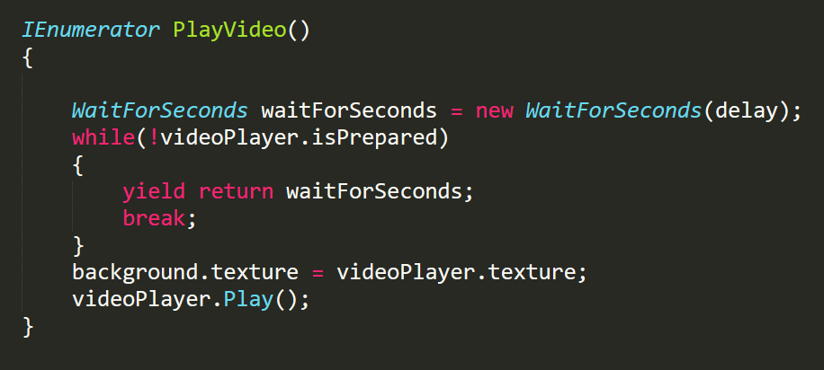
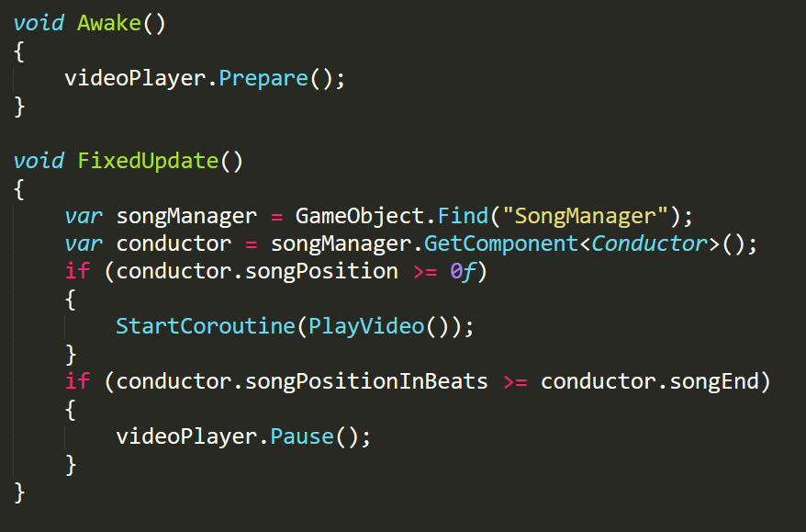
This code might seem simple, but the documentation for VideoPlayer is incredibly limited and the methodology needed to sync with separate audio is counterintuitive. This was my solution
In short, VideoPlayer has to load the video file before it can play and the time required to do that fluctuates. Waiting for it to load and asking it to play at a certain time is not consistent either. I found that WaitForSeconds can be used as a retrospective check, so I play the video at the necessary beat position and then check to make sure the correct amount of seconds has passed

Slide 4
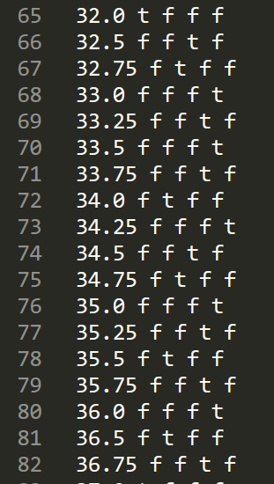
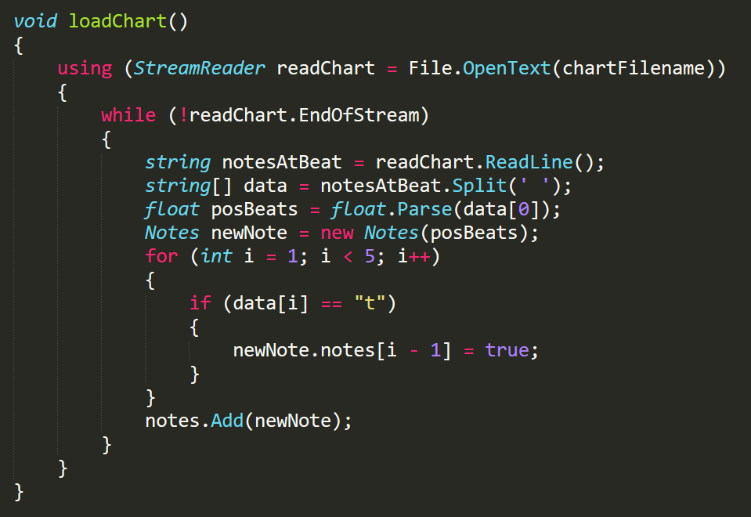
Some of my favorite code snippets. These first two are my chart loader and a chunk of a chart, respectively.

Slide 5
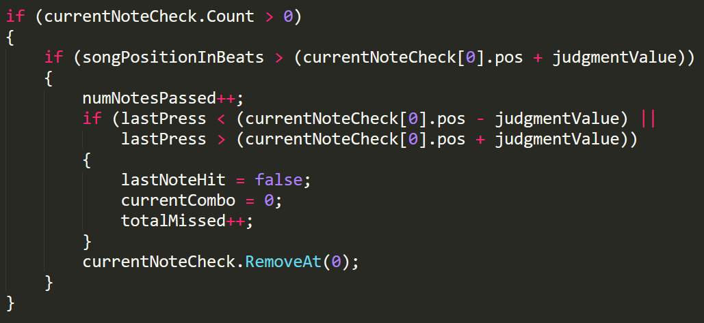
I’m also quite fond of my note miss check. I’m not using colliders and so everything is handled with vectors and math, meaning that I had to keep a running list of notes and manually remove them from gameplay when they passed the judgement bar. Then check that against the last user input

Slide 6
If I could do it all over again I would optimize, optimize, optimize.
I ended up with some variables and methods that are unnecessary since I was mostly flying blind on this.
I’ve cleaned the project a lot but I have some ideas for potential streamlining that will also increase modularity of my components
If possible, I would like to move a lot of the Conductor class into the Judgement class as right now it is more just an Input Handler, with Conductor doing 90% of the heavy lifting in the game
I plan to continue developing this indefinitely so these are all things I am going to actually implement. I learned a lot from this project and am maximally excited to apply that knowledge back to it moving forward

Slide 7
I learned a lot about C# and various Unity methods, in particular I have a much better understanding of how Awake, Start, Update, and FixedUpdate should be utilized. My favorite thing I learned about, however, was definitely StreamReader. StringStream is by far my favorite part of C++ and I’ve been deeply missing it since moving to C#. StreamReader is exactly what I was hoping existed, I just never found anyone mentioning it when I’ve needed the functionality in the past.

Slide 8
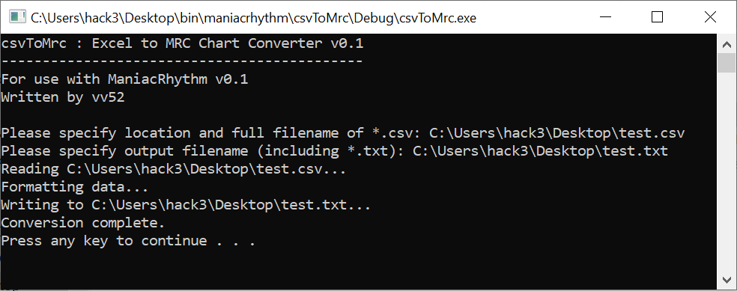
I also wrote a C++ console application to speed up song charting. It takes *.csv output from Excel, Google Sheets, or any other program that supports *.csv output and formats it in a way that allow the loadChart() method I wrote for my engine to load it. This is mostly helpful because every note spawn is tied to it’s final beat position in the song, so copying chunks of notes that repeat requires adding a constant to every float value by hand. Spreadsheet applications support column arithmetic, which makes this far less tedious

Slide 9
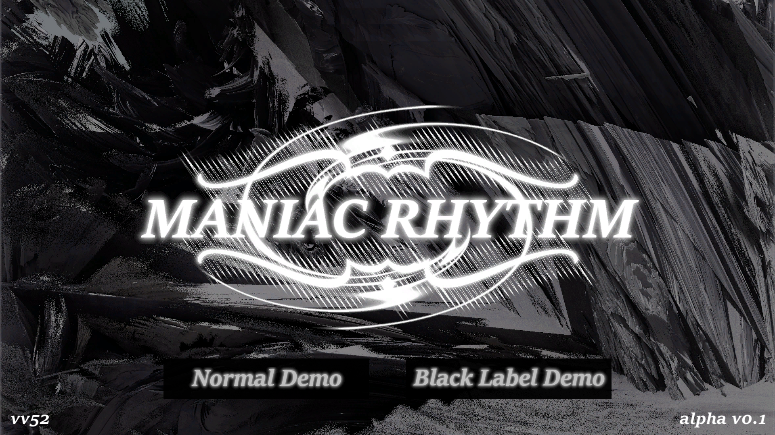

Slide 10
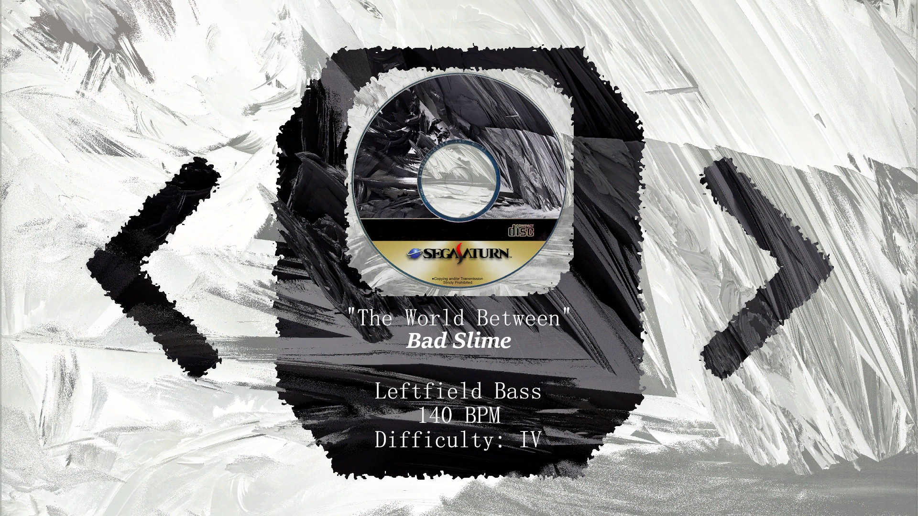

Slide 11
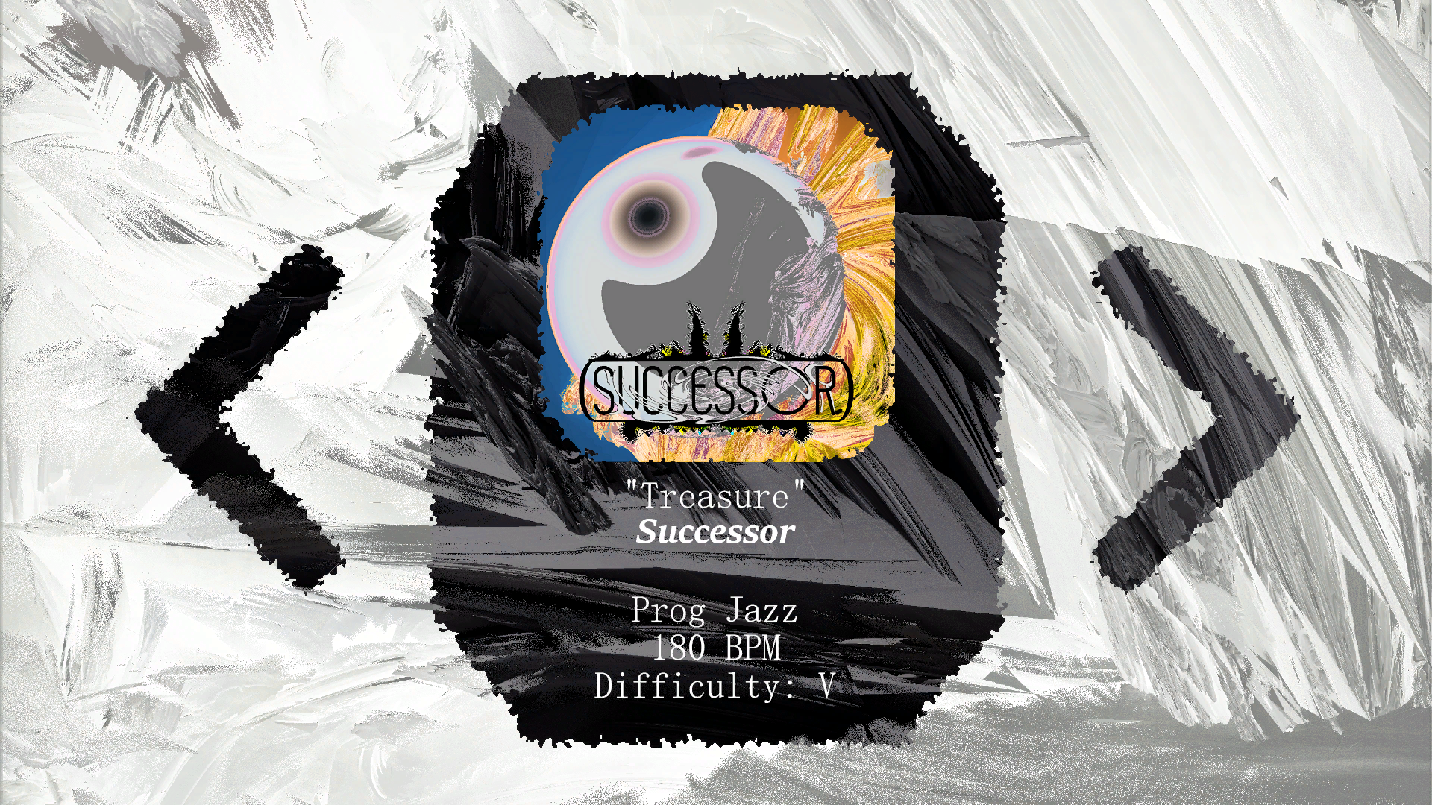

Slide 12
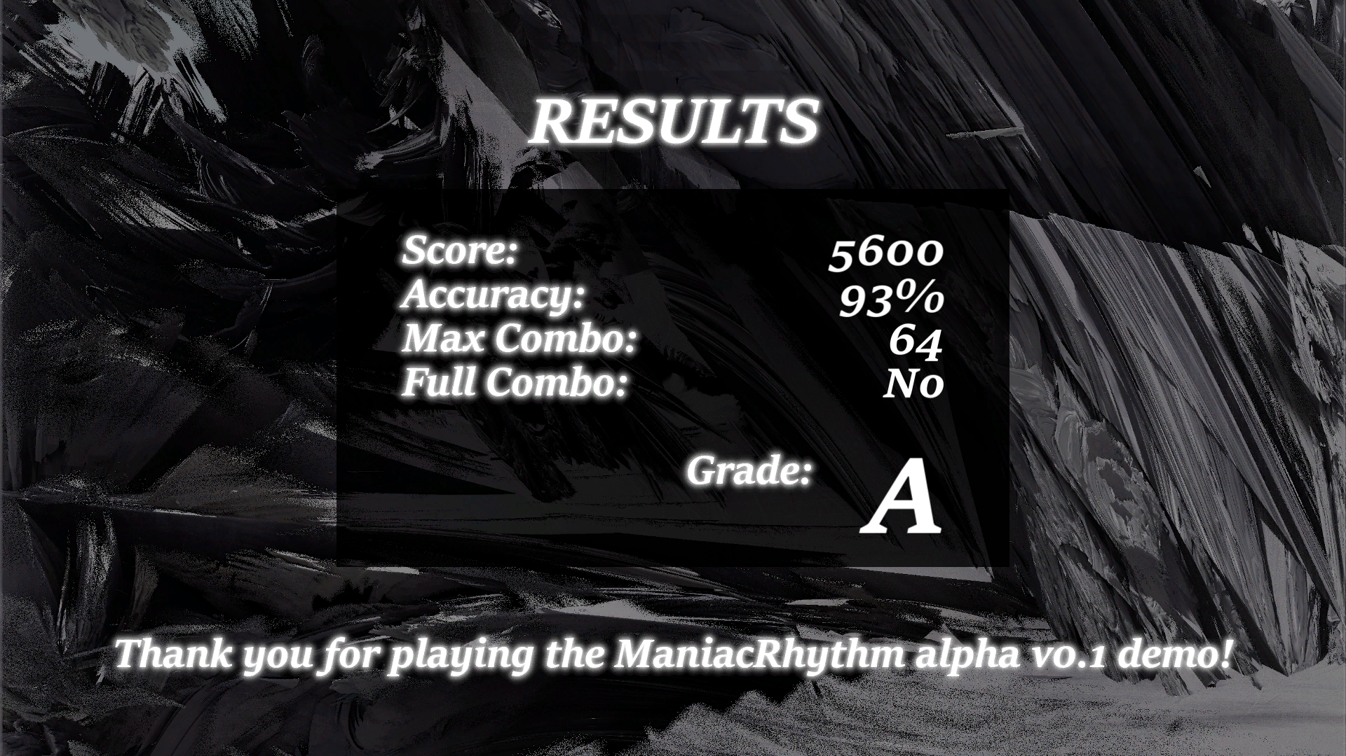

Slide 13

Thank you for watching my presentation!
If you’re interested in trying this game at some point or keeping up with the development, I’ve started a discord for it!
Permanent link: https://discord.gg/uGX4qY2

